Slide 1
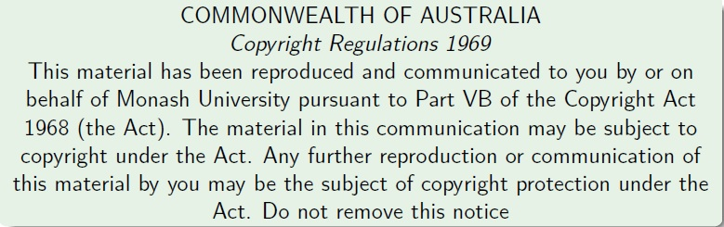
Faculty of Information Technology, Monash University

Slide 2
FIT2004: Algorithms and Data Structures
Week 12: Topological Sort and Design Principles
These slides are prepared by M. A. Cheema and are based on the material developed by Arun Konagurthu and Lloyd Allison.

Slide 3
Overview
Topological Sort
Kahn’s Algorithm
Depth First Search
Final Exam etc.

Slide 4
Directed Acyclic Graph (DAG)
A Directed Acyclic Graph (DAG) is
Directed
Acylcic – has no cycles
Graph
Which of the two graphs is a DAG?
B
D
B
D
A
A
C
E
C
E
Graph 1
Graph 2

Slide 5
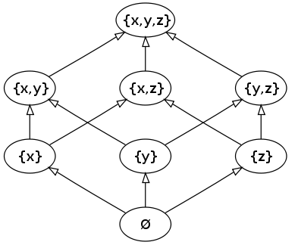
DAG: Examples
sub-tasks of a project and which “must finish before”
A → B means task A must finish before task B
so, DAGs useful in project management
relationships between subjects for your degree -- “is prerequisite for”
A→B means subject A must be completed before enrolling in subject B
people genealogy – “is an ancestor of”
A → B means A is an ancestor of B
power sets and “is a subset of“
A → B means A is a subset of B
B
D
A
C
E
Source: wikipedia

Slide 6
Topological Sort of a DAG
Order of vertices in a DAG
A < B if A→B.
Note that if A → B and B→D, we have A < B and B < D which implies that A < D (i.e., transitivity).
Some vertices may be incomparable (e.g., B and C are incomparable), i.e. A< B and A < C but we do not know whether C < B or B < C.
A topological Sort
is a permutation of the vertices in the original DAG such that
for every directed edge u→v of the DAG
u appears before v in the permutation
Example: A, B, C, E, D
Topological sort of a DAG of “is prerequisite of” example gives an ordering of the subjects for studying your degree, one at a time, while obeying prerequisite rules.
B
D
A
C
E

Slide 7
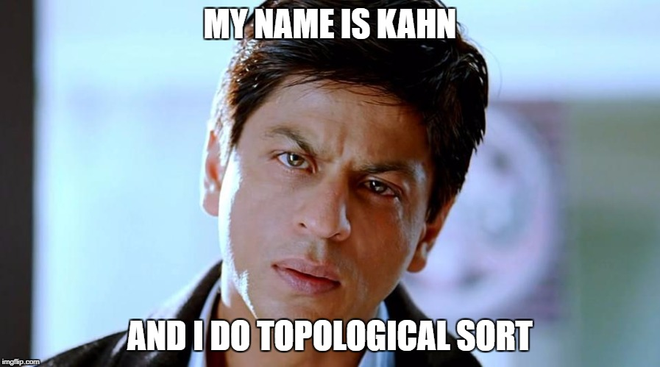
Topological Sort of a DAG
A DAG can have many valid topological sorts, e.g., let u and v be two incomparable vertices, u may appear before or after v.
Which of these is NOT a valid topological sort of the DAG
A, B, C, E, D
A, C, B, E, D
A, C, E, B, D
A, B, E, C, D
How to do topological sort?
Kahn’s Algorithm
B
D
A
C
E

Slide 8
Overview
Topological Sort
Kahn’s Algorithm
Depth First Search
Kahoot Grand Finale
Design Principles (FIT2004 Summary)
Programming Competition Winners
Final Exam etc.

Slide 9
Kahn’s Algorithm: High level idea
For each vertex v that does not have ANY incoming edge
Add v to sorted
Remove the outgoing edges of v
B
D
A
C
E
Sorted:
A
B
C
E
D

Slide 10
Kahn’s Algorithm: Detailed pseudocode
initialize Sorted to be empty # Sorted will contain the topological sort
initialize a list L with vertices that do not have any incoming edge
while L is not empty:
remove any vertex v from L
Sorted = Sorted + {v}
for each outgoing edge v → u of v:
remove edge v → u from the graph
if u has no other incoming edge:
insert u in L # all the vertices that must appear before u have already been added to Sorted
if graph still has some edges:
return error # graph has a cycle
else:
return Sorted
?
Time Complexity?
?
B
D
A
C
E
L:
A
B
E
C
D
Sorted:
A
B
C
E
D

Slide 11
Kahn’s Algorithm: Complexity
initialize Sorted to be empty # Sorted will contain the topological sort
initialize an array IncomingEdges[] of size V with all values set to 0
for each edge u → v in E:
IncomingEdge[v] += 1
initialize a list L containing vertices for which IncomingEdges[v] = 0
while L is not empty:
remove any vertex v from L
Sorted = Sorted + {v}
for each outgoing edge v → u of v:
remove edge v → u from the graph
IncomingEdges[u] = IncomingEdges[u] - 1
if IncomingEdges[u] == 0: # u has no incoming edge
insert u in L
if graph still has some edges:
return error # graph has a cycle
else:
return Sorted
O(E+V)
O(E+V)
B
D
A
Time Complexity: O(V+E)
Space Complexity: O(V+E)
C
E

Slide 12
Overview
Topological Sort
Kahn’s Algorithm
Depth First Search
Final Exam etc.

Slide 13
Depth First Search (DFS)
Below is the DFS algorithm we saw in week 8
function DFS(v):
Mark u as Visited
For each adjacent edge (v,u)
If u is not visited
DFS(u)
Assume we call DFS(A), which of the following is NOT a possible order in which vertices are marked visited.
A, B, D, C, E
A, C, E, D, B
A, C, D, E, B
A, C, E, B, D
B
D
A
C
E

Slide 14
DFS for Topological Sort
Using DFS for topological sort assuming graph is a DAG!
For each vertex v that does not have any incoming edge:
Call DFS(v)
function DFS(v):
For each adjacent edge (v,u)
If u is not visited
DFS(u)
Mark v visited and append in Sorted (at front)
Time and space complexity:
O(V+E)
B
D
A
C
E
Not accessed:
DFS not finished yet:
Sorted:
Sorted:
A
C
E
B
D

Slide 15
Overview
Topological Sort
Kahn’s Algorithm
Depth First Search
Design Principles (FIT2004 Summary)
Programming Competition Winners
Final Exam etc.

Slide 16
Overview
Topological Sort
Kahn’s Algorithm
Depth First Search
Kahoot Grand Finale
Design Principles (FIT2004 Summary)
Final Exam etc.

Slide 17
Design Principles (Summing up FIT2004)
Here are some broad strategies to (try to) solve algorithmic problems:
Look out for good invariants to exploit
Attempt to balance your work as much as possible
Do not repeat work (so, store and re-use!)
Use appropriate data structures
Try well-known problem solving strategies
Sometimes greed is good!
These are general guidelines. As always, there are many exceptions

Slide 18
Look out for good invariants to exploit
Here are some algorithms we considered in the unit that do precisely this!
Binary Search (Refer Week 2 lecture)
Sorting (Refer Lectures from Weeks 2 and 3)
Shortest Paths and Connectivity
Dijkstra’s algorithm (Refer Week 8 Lectures)
Floyd-Warshall algorithm (Refer Week 9 lectures)
Minimum Spanning Tree Algorithms (Refer Week 10 lectures)

Slide 19
Balance your work as much as possible
For problems that allow division of labour (eg. Divide and Conquer)
Try to divide work equally as much as possible
Merge sort achieves this
O(N log N)-time always!
Quick sort does not necessarily achieve this – depends on the choice of the pivot (Refer week 3)
Good pivots give O(N log N)-time
Bad pivots give O(N²)-time

Slide 20
Choose Data Structures with care
Certain data representations are more efficient than others for a given problem
Priority Queue in Dijkstra’s algorithm (Refer Week 8)
Union-Find data structure in Kruskal’s algorithm (refer Week 9)
Efficient Search and retrieval data structures of various kinds (Refer Weeks 5,6,7 lectures)

Slide 21
Don’t repeat work
Do not compute anything more than once (if there is room to store it for reuse)
Underpins Dynamic Programming strategy
Edit Distance (Refer Week 4 Lecture)
Knapsack Problem (Refer Week 4 Lecture)

Slide 22
Try well known problem solving strategies
Divide and Conquer (Refer Weeks 3, 4 lectures)
Dynamic Programming (Refer Weeks 4, 8, 9 lectures)

Slide 23
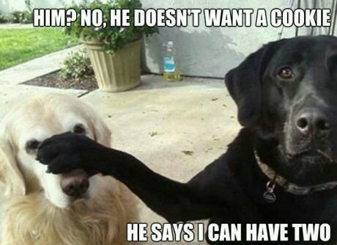
Sometimes greed is good
A greedy strategy is to make a “local” choice based on current information
Sometimes gives optimal solution, e.g.
Dijkstra’s single source shortest paths algorithm (Refer Week 8 Lectures)
Minimim Spanning Tree Algorithms – Prim’s and Kruskal’s (Refer Week 10 lectures) minimum spanning tree algorithm.
Greedy is sometimes a good heuristic!
Sometimes gives a “good” solution to a (combinatorial) problem even if not guaranteed optimal

Slide 24
Overview
Topological Sort
Kahn’s Algorithm
Depth First Search
Design Principles (FIT2004 Summary)
Final Exam etc.

Slide 25
Final Exam
Time allowed: 2 hours + 10 minutes reading time
Total Marks: 60
Exam is NOT open book
Question style similar to mid-semester tests – but do not try to guess what will be on the exam
If a question asks you to describe an algorithm, you can write your idea in plain English
If a question asks you to write pseudocode, you must write your idea in a more structured way (like the ones in lecture slides or even Python code)
Hurdles:
At least 16 out of 40 marks in in-semester assessments (assignment + mid-semester test + lecture/tutorial participation)
At least 24 out of 60 marks in the final exam
At least 50 marks overall
Do not miss final exam even if you fail in-semester hurdle.
It affects your WAM

Slide 26
Non-Examinable Content
Additional material in lecture notes is NOT examinable
In other words, anything NOT covered in lectures, tutorials, labs is NOT EXAMINABLE!
Advanced questions in tutorials are NOT examinable

Slide 27
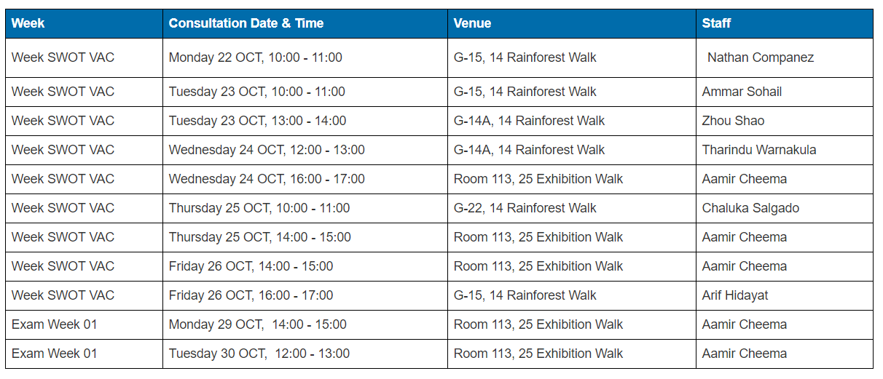
Consultations for Final Exam
Consultation sessions have been organized
At least one each day
Please check Moodle before attending the consultation

Slide 28
Consultations for Final Exam
Please come to the consultations prepared
Do not ask questions like “Can you please explain Dynamic Programming from scratch?”.
Don’t try getting hints about the questions on final exam!
E.g., Is Kruskal’s algorithm going to be on the exam?
Important: Last night I got an accident and have lost my memory – so do not waste your energy
Only I, Ammar (head tutor), Ian (lecturer at Malaysia campus) and the Chief Examiner have seen the exam paper. Some of the options you have are the following
Selfish Option
In many Bollywood movies, a second accident brings the memory back.
Pray that I get another accident
but the second accident may bring false memories and you may get all the wrong hints :P
Risky Option
Ask Ammar. He has told me that he will lie to you :P
Expensive Option
Buy a ticket to Malaysia and try your luck by talking to Ian :P
Useless Option
Ask the Chief Examiner
I am the Chief Examiner :P
Easiest Option
Study!!!

Slide 29
Suggestions for preparation (written after I lost my memory)
Understand how each algorithm works
Practice writing pseudocode for each algorithm
Understand its complexity analysis
Don’t confuse algorithms: Bellman-Ford vs Floyd-Warshall vs Ford-Fulkerson
Despite warning, every semester, students mix up algorithms losing all marks for the question
Solve different recurrence relations
Prove by induction for recurrence solutions
Practice writing proofs of correctness of algorithms

Slide 30
Algorithm for exam preparation
for i in range(1,13):
carefully go through lecture slides and lecture notes week i and ensure you understand the content
practice writing pseudocode for each algorithm covered in week i
make sure your understand space/time complexities
if something is unclear:
listen lecture recording # slides are optimized for lectures and should only be treated as summaries.
seek help
for i in range(2,13):
attempt tutorial questions week i
for each question attempted:
compare your solution with the sample solution
seek help if something is unclear
for each question on the sample exam and mid-semester tests:
attempt the question
post your solution on Moodle forum
If current_date <= exam_date
goto line 1
Print(“HURRAYYYYYY!!! I did it!”)
# WARNING: This is a brute force algorithm. Using greedy algorithm (studying selected topics) may be disastrous

Slide 31
Summary
Take Home Message
See Design Principles in this lecture
Things to do (this list is not exhaustive)
See the algorithm to prepare for final exam
Coming Up Next

Slide 32

Coming Up Next
SWOT VAC

Slide 33

Coming Up Next
Final Exam

Slide 34

Coming Up Next
Results Day
And you live happily ever after

Slide 35

Coming Up Next (Second Scenario)
SWOT VAC

Slide 36

Coming Up Next (Second Scenario)
Final Exam

Slide 37


Coming Up Next (Second Scenario)
Results Day
Moral: Work hard or be brave!

Slide 38


Just before I sign off …
Most of you have done really well given the challenging nature of the unit!
Good luck for the final exam!
Do not hesitate to contact me if I can be of any help even after this semester
E.g., if you need a reference letter

Slide 39

That’s all folks!

Slide 40
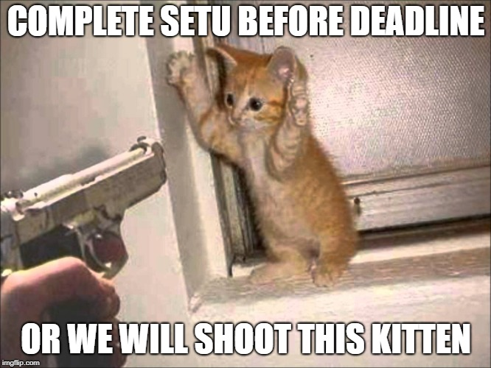
Announcements/Things to note
Complete SETU before it closes (28th October)
Assignment 4 Feedback
Written feedback will be provided for assignment 4
Attend a consultation to get face-to-face feedback (optional)
You must attend a consultation offered by your marker
Pre-exam consultation sessions (also available on Moodle)

Slide 41
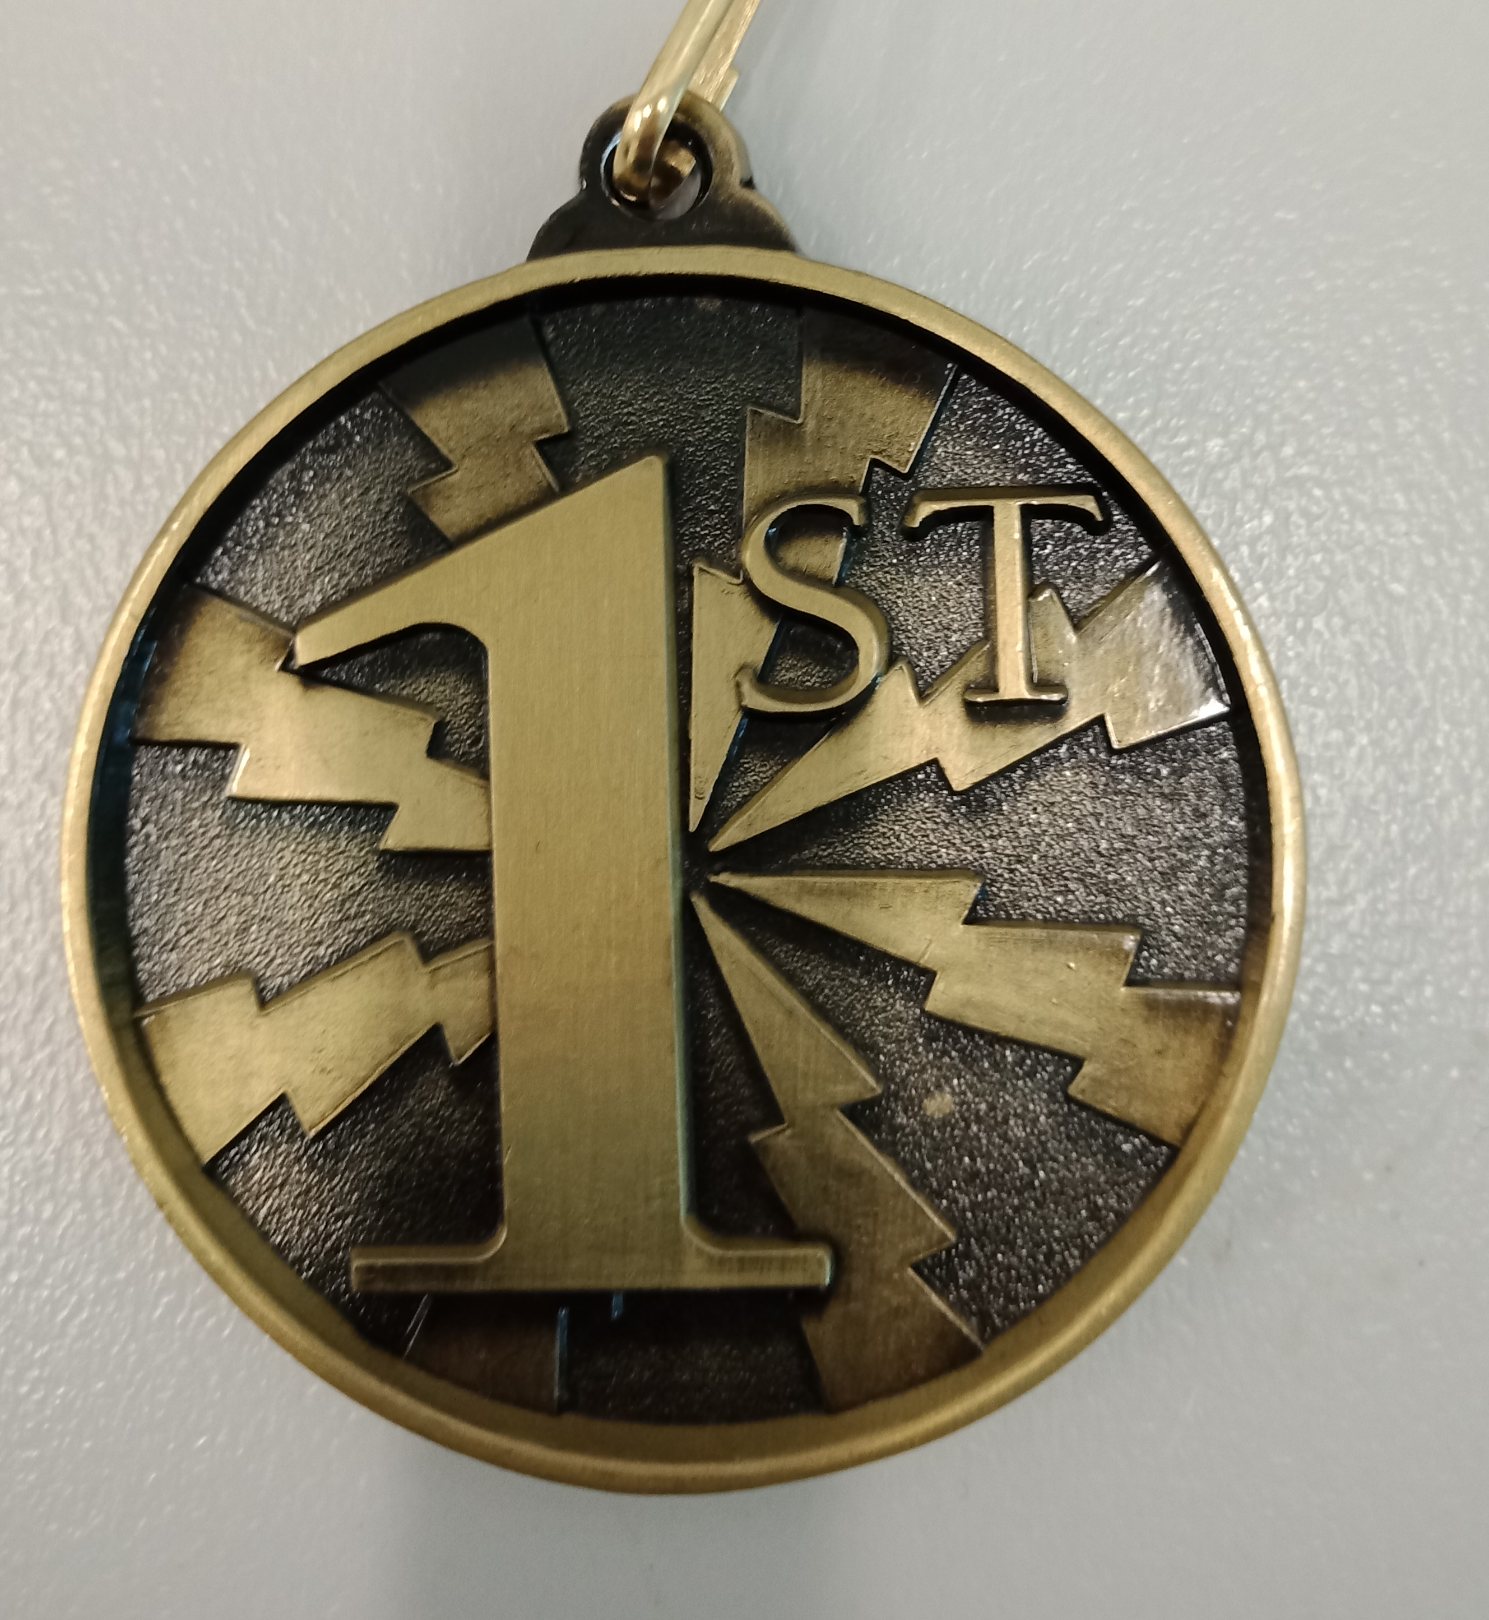
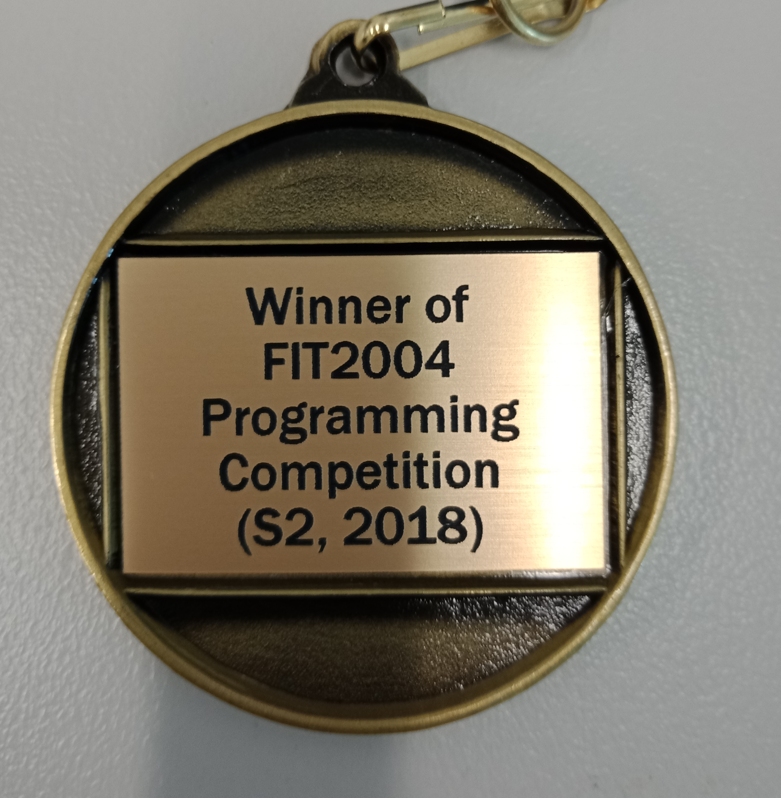
Programming Competition Winners
Honorable mention: Siddhant Dube (solved 7, penalty 8)
5th: Zifeng Guo (solved 8, penalty 3)
4th: Lim Zhi Rong (solved 8, penalty 0)
3rd: Marcus Paige Rendell (solved 9, penalty 9)
2nd: Harsil Patel (solved 10, penalty 7)
Champion: Marc Alexander Robert Distel (solved 12, penalty 7)

